Slide 1
J. C. Bose University of Science and Technology, YMCA Faridabad, Haryana - 12006
Community College of Skill Development
WEB DEVELOPMENT
Submitted by
UNIVERSITY ROLL NO. | STUDENT NAME
20021251502 | ANJANI
20021251504 | ANSHU KUMARI

Slide 2
WEATHER-IN Web Application

Slide 3
WEATHER
Weather is the state of the atmosphere, describing for example the degree to which it is hot or cold, wet or dry, calm or stormy, clear or cloudy. on earth, most weather phenomena occur in the lowest layer of the planet's atmosphere, the troposphere, just below the stratosphere. weather refers to day-to-day temperature, precipitation, and other atmospheric conditions, whereas climate is the term for the averaging of atmospheric conditions over longer periods of time. when used without qualification, "weather" is generally understood to mean the weather of earth

Slide 4
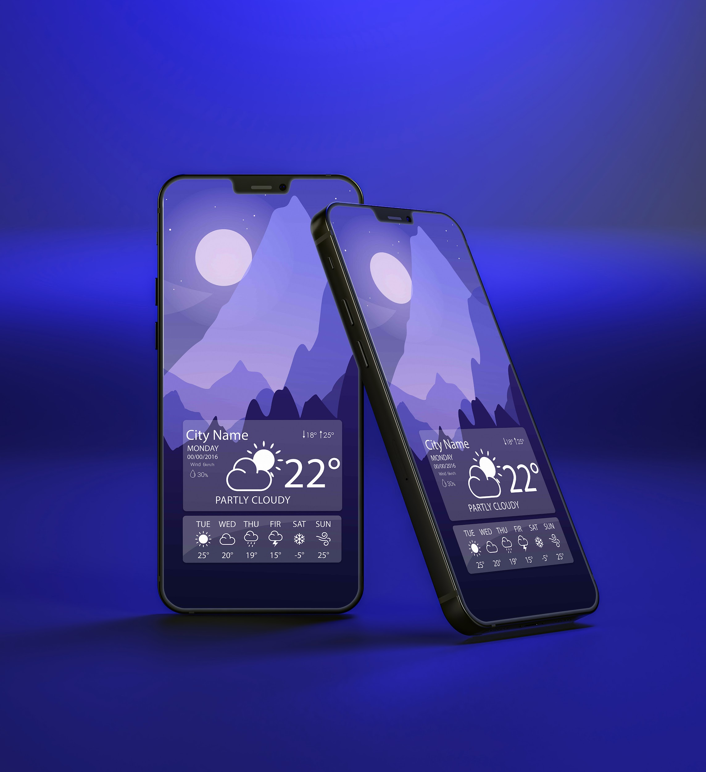
Weather App
Knowing what the day will bring is one good way to making a perfect plan for each day. sometimes this is usually a difficult one for all us because nobody really knows for certain what is likely to happen in the nearest minutes. even in the area of the weather, this is paramount.
in order to minimize the risk of distorted daily plans and arrangements, owing to changes in weather, there is need to take close looks daily weather condition – which means determining what the weather is likely to bring for the day.
This goes to help us realize the need and importance of weather forecast and it’s instruments, including a weather app.

Slide 5
Why we need weather app
To plan journeys ahead.
To plan meeting/commute timings
To decide what to wear
Be able to see weather forecast at different places.
Some travellers may need to know more details about the weather such as visibility , chances of rainfall , humidity etc.

Slide 6
WEATHER MAP
Your City
Mon
Tue
Wed
Thu
Fri
Sat
Sun

Slide 7
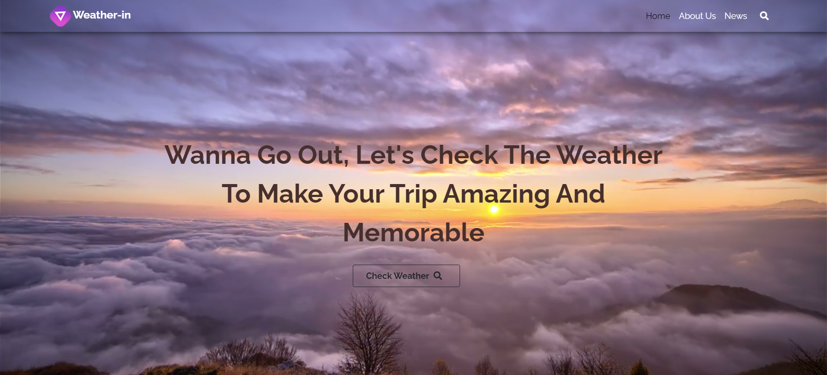
SITE INTERFACE – LANDING PAGE

Slide 8
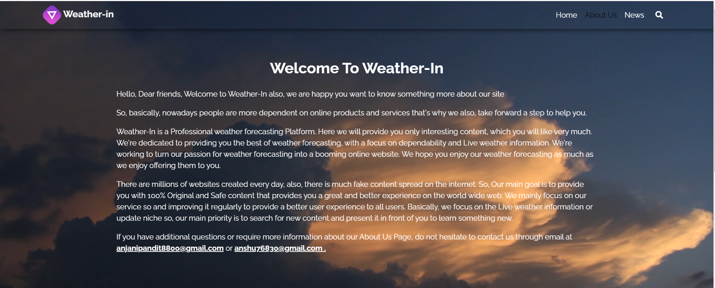
ABOUT US PAGE

Slide 9
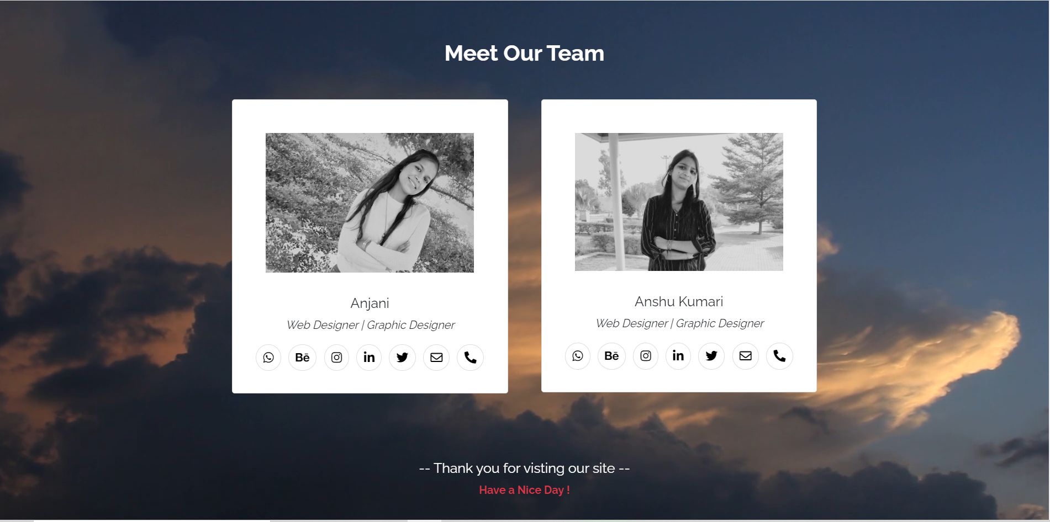
Our Team Page:

Slide 10
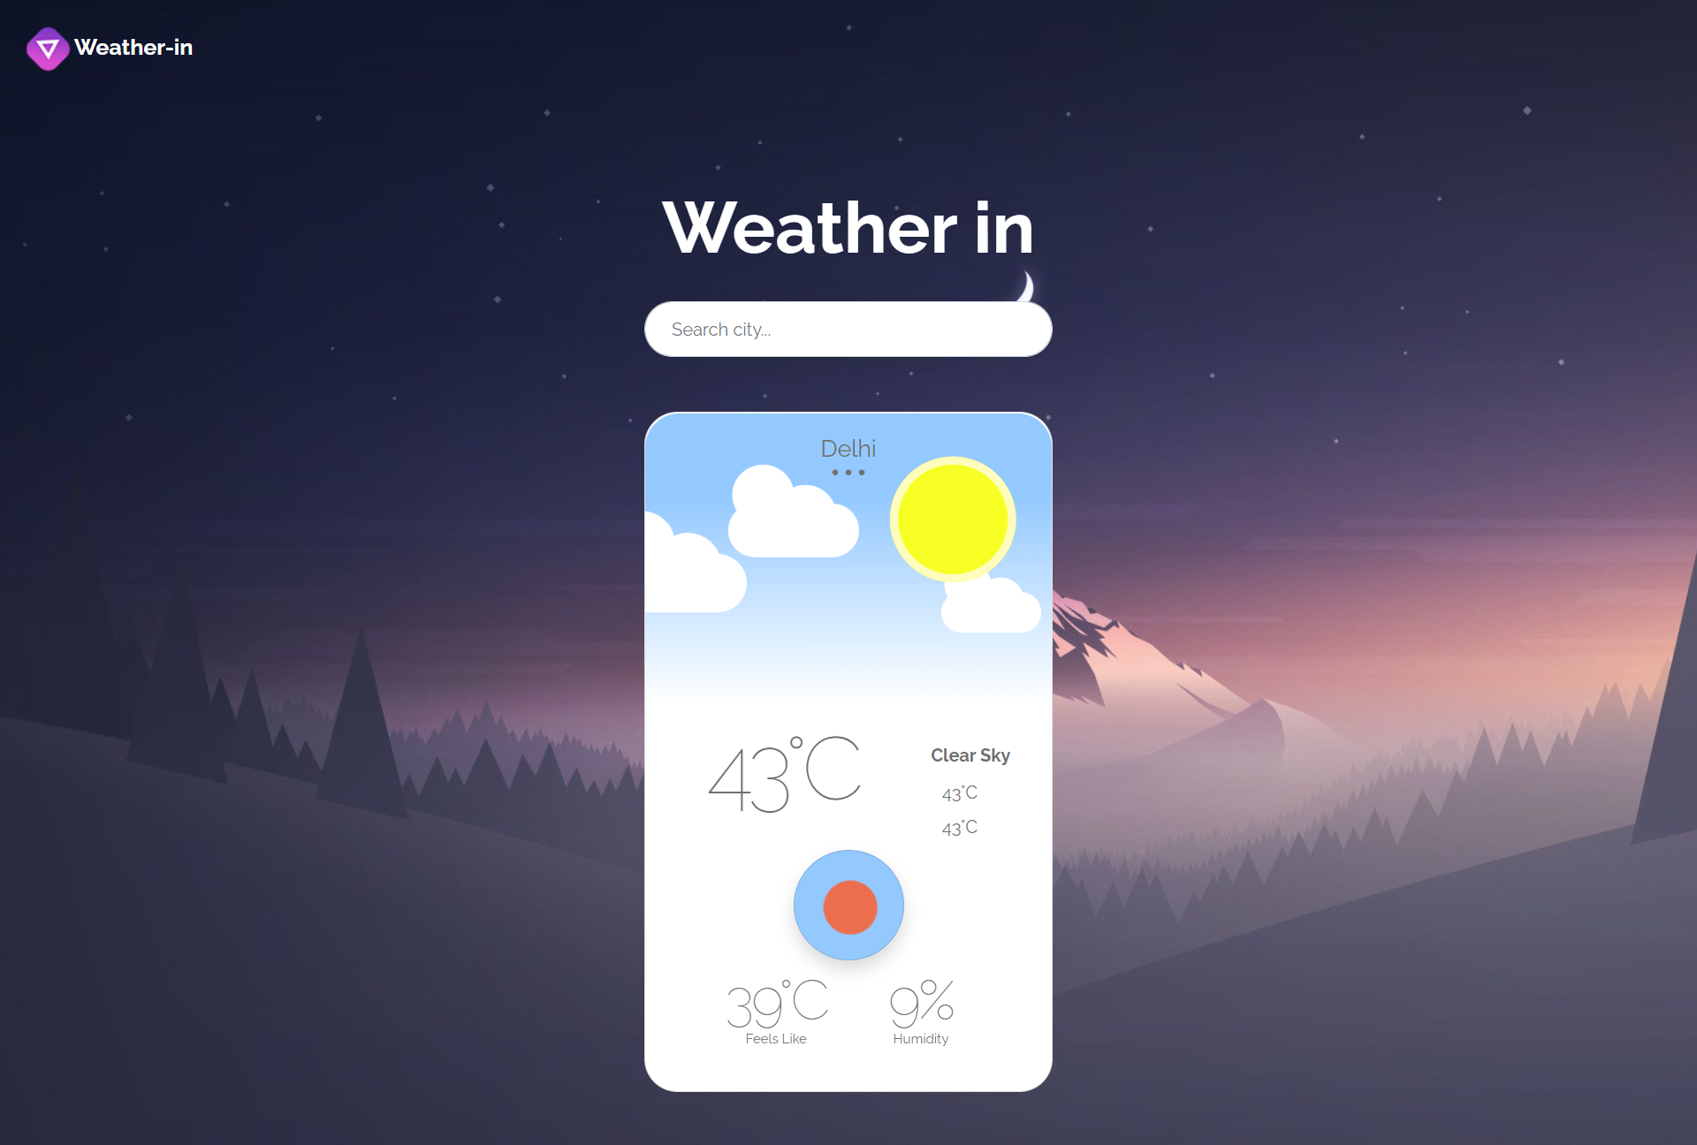
Check Weather Page:

Slide 11
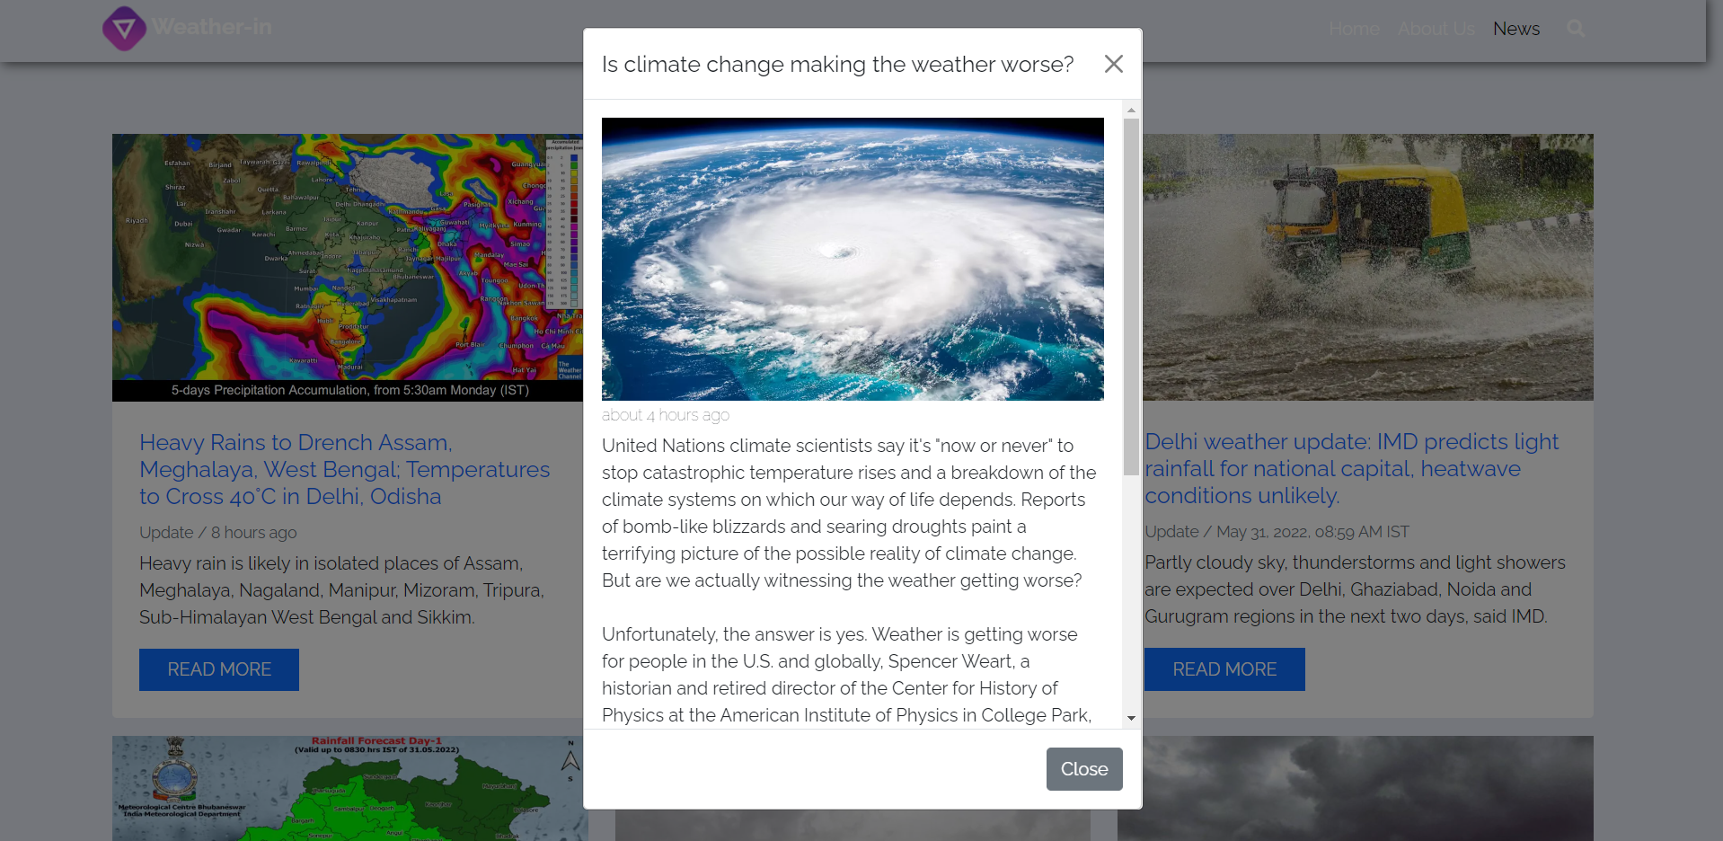
News Page:

Slide 12
THANKS !

